Slide 1
Twin Lakes Resort
Right of Way Vacation Pt. 3

Slide 2
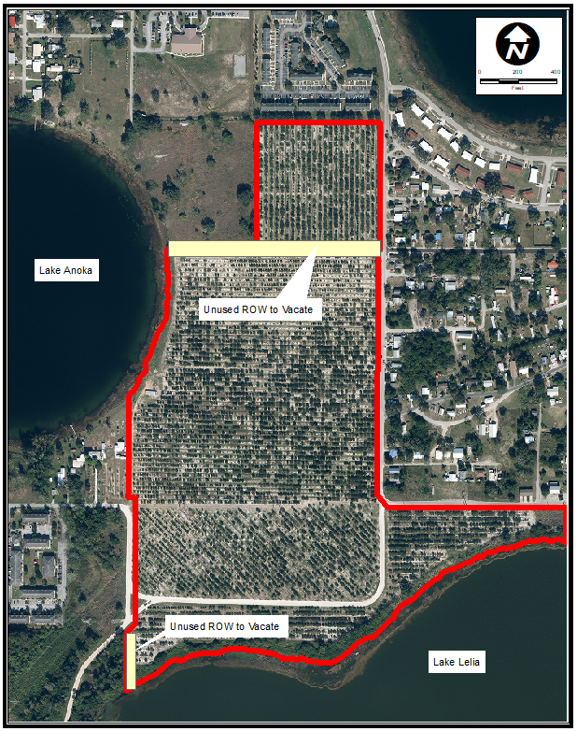
Aerial of Site

Slide 3
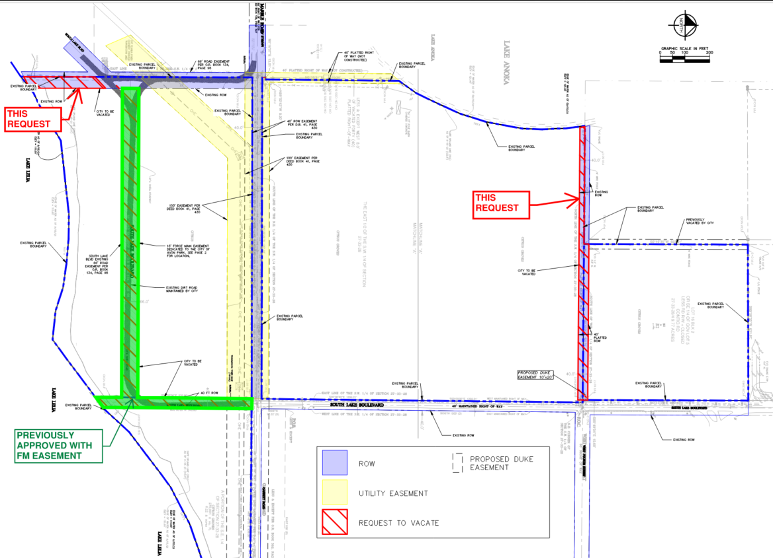
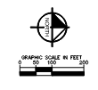
Proposed ROW to Vacate

Slide 4
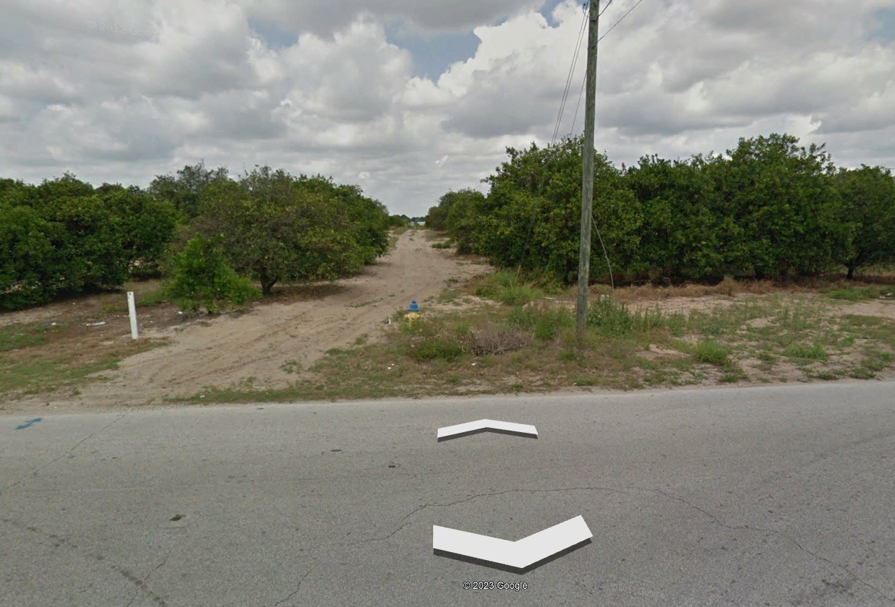
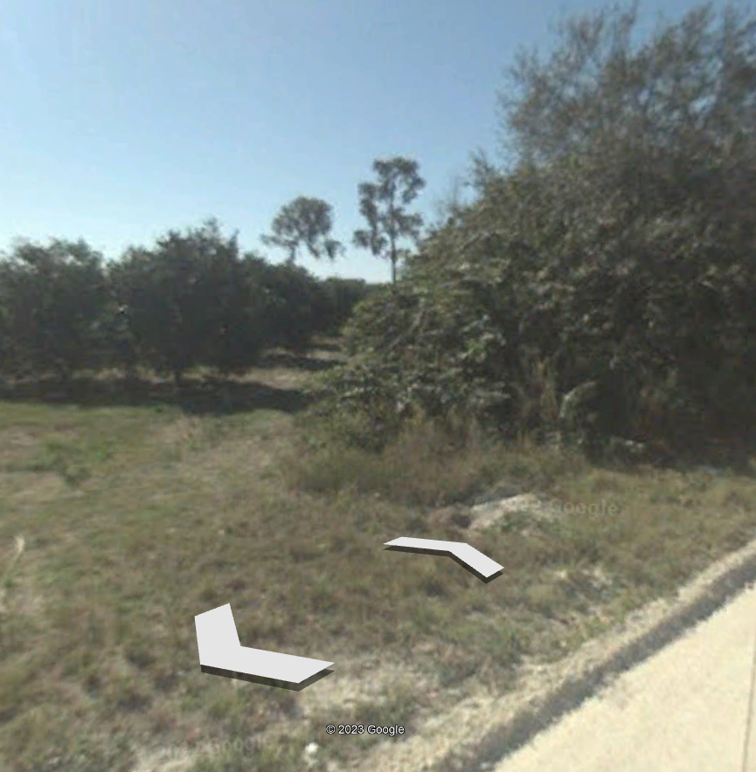
Current Status
Unused (except for farming operations)

Slide 5
Key Takeaways
Unused ROWs (except for farming operations)
No community impacts from this vacation
Continuation of previous approval to allow development of site

Slide 6
THANK YOU!

