Slide 1
CRA Board Training
January 20, 2023

Slide 2
Presenter: Dr. Jeff Burton FRA-RA, MPA
City of Tampa Urban Core Redevelopment Agencies
University of South Florida, Training Faculty
Former President, Florida Redevelopment Association (FRA)

Slide 3
Florida Statute 163.335 (1) Identifying Areas for Redevelopment

Slide 4
Defining Slum and Blight
F.S. 163.335(1) Defines Slum and Blight areas as:
Areas which injure resident’s public health, safety, morals and welfare.
Areas that spread disease and crime. CRA areas tend to have more crime because of a lack of employment opportunities and slum lords.
Areas that create economic and social liabilities by imposing an onerous burden (how?):
Decreases the tax base: lowered property values, lack of investment into the community leading to…
Reduced Tax Revenue
Loss of money caused by “slum lords,” and those who profit from illegal activity. Costs the City through services, i.e., utilities, Code Enforcement, Sanitation, Etc.
Impair or halt sound growth
Delay housing accommodation
Worsen and prevent traffic hazard elimination
Areas that are a focal center of disease, for example, Knickerbocker Village in New York (the Lung Block/Tuberculosis)
Promote Juvenile Delinquency
Consumes excessive revenue through police, fire, accident, hospitalization, and other municipal services

Slide 5
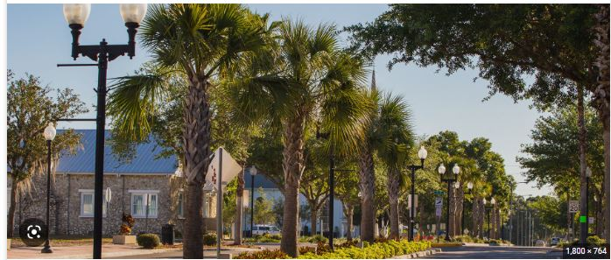
Florida Statute 163.340 (9) Our Responsibilities as a CRA

Slide 6
Our Role as a CRA
F.S. 163.340(9) asserts as a CRA, we are to:
Eliminate and prevent the development or spread of slum and blight, or
Reduce and prevent crime, or
Promote affordable housing whether for rent or for sale, to residents of low (80% AMI*) or moderate (120%) income, including the elderly. This may include:
Slum clearance and redevelopment in a CRA
Incentivizing development in CRA areas

Slide 7
Florida Statute 163.370 (2) How Do We Redevelop Our Community?

Slide 8
What We Can Do as a CRA
F.S. 163.370(2) asserts as a CRA, we can:
Contract work (purchase property)
Spread information about slum clearance and community redevelopment
Acquire, improve, hold, clear, prepare, and dispose of property at Fair value:
The statute defines acquire to mean purchase, lease, option, gift, grant, bequest, devise, or other voluntary methods of personal or real property
Demolish buildings and improvements, for example, Brownfield mitigation and projects
Plan, survey, appraise, study, rezone, close, and vacate

Slide 9
What We Can Do as a CRA, Continued
F.S. 163.370(2) asserts as a CRA, we can:
Mortgage, pledge, hypothecate (pledge money by law for a specific purpose) or encumber, or dispose of real property
Solicit RFPs for real parcel redevelopment contemplated by a CRA plan to be acquired for redevelopment purposes by the CRA pursuant to 163.380
Borrow money and apply for, and accept advances, loans, grants, contributions and any other form of assistance
Plan voluntary or compulsory (required by law, i.e., special magistrate orders, etc.,) repair and rehabilitation and improvements
Plan enforcement of state and local land use and occupancy laws, codes, and regulations

Slide 10
What We Cannot Do as a CRA
F.S. 163.370(3) asserts as a CRA, we cannot:
Use eminent domain as a function of redevelopment
Build public buildings, except for:
Police Departments as part of the CRA Plan’s Community Policing Innovation (mentioned on previous slide)
Public Buildings agreed upon by each taxing authority, i.e., Florida Department of Revenue, Highlands County Tax Collector, etc.
Install, construct, reconstruct, repair or alter any publicly owned improvement projects currently on the governing body’s CIP. There must be a 3-year waiting period
Offset general government expenses unrelated to the planning and carrying out of the CRA plan

Slide 11
Items of Note…

Slide 12
Statutes and Rules of Thumb Worth Noting
F.S. 163.387(1-A) Explains Tax Increment Finance (TIF) which are used to calculate Increment Revenue
F.S. 163.370 (2) Explains how CRAs spend TIF dollars to include:
Administrative and overhead expenses
Redevelopment Planning, surveys, & financial analysis
Acquisition of real property in the CRA district
Clearance/preparation & relocation of occupants
Repayment of borrowed funds
All expenses related to bonds and other indebtedness
Development of low to moderate income housing

Slide 13
Statutes and Rules of Thumb Worth Noting
F.S. 163.370 (2), continued:
Capital expenditures
Promotion and marketing as a means of the dissemination of CRA information
Incentives and grants
Land Acquisition
Cost sharing/allocation for services
Sometimes, maintenance and repairs

Slide 14
Statutes and Rules of Thumb, Worth Noting
Chapter 189 provides detailed district information, including: posting and reporting requirements, CRA budget adoption, and filing fees
Chapter 218 provides information on the CRA Annual financial reports and requirements
Chapter 163 Part III, provides additional information on advertising requirements for the CRA local annual report
F.S. 163.3340(8) provides definitions for Blight
F.S. 163.370(2) provides information concerning Administrative Costs
F.S. 163.387(b) provides information about Interlocal Agreements
Attorney General Opinions of Note include:
Market/direct funding events, AG-2010-40
Funding non-profits- AG-2010-40

Slide 15
Statutes and Rules of Thumb, Worth Noting
Rules of Thumb:
ANYTHING done as a part of the CRA, must be in the CRA plan. Otherwise, you cannot do it
Let your experts be experts
There is no value engineering with CRAs
Do not confuse CRAs with Community Reinvestment Act Funds. It is not the same
Do not cross your money streams. Each CRA District’s funds are meant for that specific district. They are never to be comingled

Slide 16
Thank you for the Opportunity!

